Slide 1
Professional & Personal Development:
Session 2: Working in a company as a web-developer

Slide 2
Introduction
Consider a previous job that you have had.
Who did you report to?
Who reported to you?
Did you work as a member of a team or in a department with people with different roles and tasks? How were your tasks complementary?
Who were your clients? Were they internal or external clients? How much engagement did you have with them?
Can you think of someone (a manager, co-worker or other) who you had a difficult, unproductive relationship with? What was the cause?
Can you think of someone (a manager, co-worker or other) who you had a good, productive relationship with? What was the cause?

Slide 3
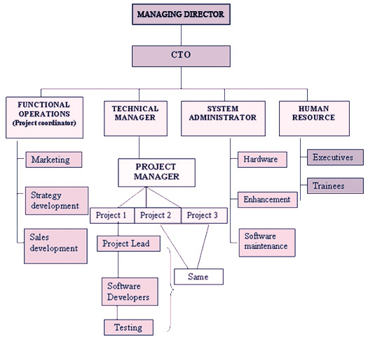
Company Structures 1

Slide 4
Company Structures 2
Business Development
Development
Product & Project Management

Slide 5
Company Structure and the Developer’s role
Consider the various company structures:
What are the similarities and differences in the role of a web-developer in the different structures/environments?
How does the role of a web-developer changes in terms of the following?
Level of control and direction
Broader or narrower role
Interface with clients (and degree of)
Internal or external clients
Ordered working environment or “seat of the pants”
What’s the difference in the role of a Line Manager and a Project Manager?
What does a Project Manager want/expect from developers?

Slide 6
The successful Developer…
What are the crucial elements in being a successful coder in all environments?
What do the following mean to you?
The web-developer needs to understand how what they are developing fits into a bigger whole
The Web-developer needs to be a constructive and productive team-member
Communication

Slide 7
Giving and Receiving Feedback
To who and when do you give and receive feedback? Consider:
Formal feedback
Informal feedback
How do you give and receive feedback? Consider:
Content & interaction patterns
Tone of voice
Non-verbal communication
Posture
Body language
Facial expression
Eye contact
What guidance would you give in realtion to giving and receiving feedback to support the development of constructive, productive relationships with managers and co-workers? Why?
Dos | Don’ts

